Slide 1
Project proposal
Due next Friday (March 29th)
1 page description of what you plan to focus on for your final project.
***Extra credit for including a BioRender figure in proposal***

Slide 2
Check-in

Slide 3
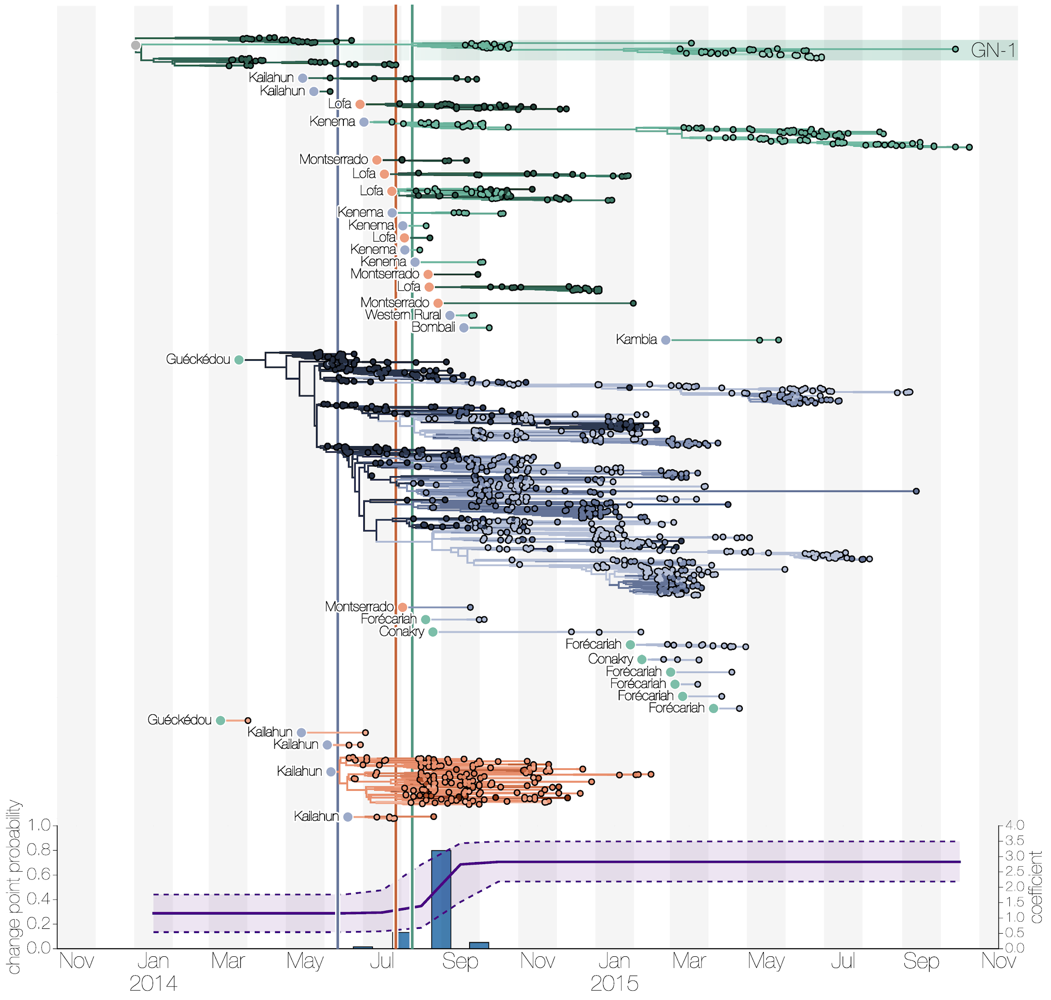
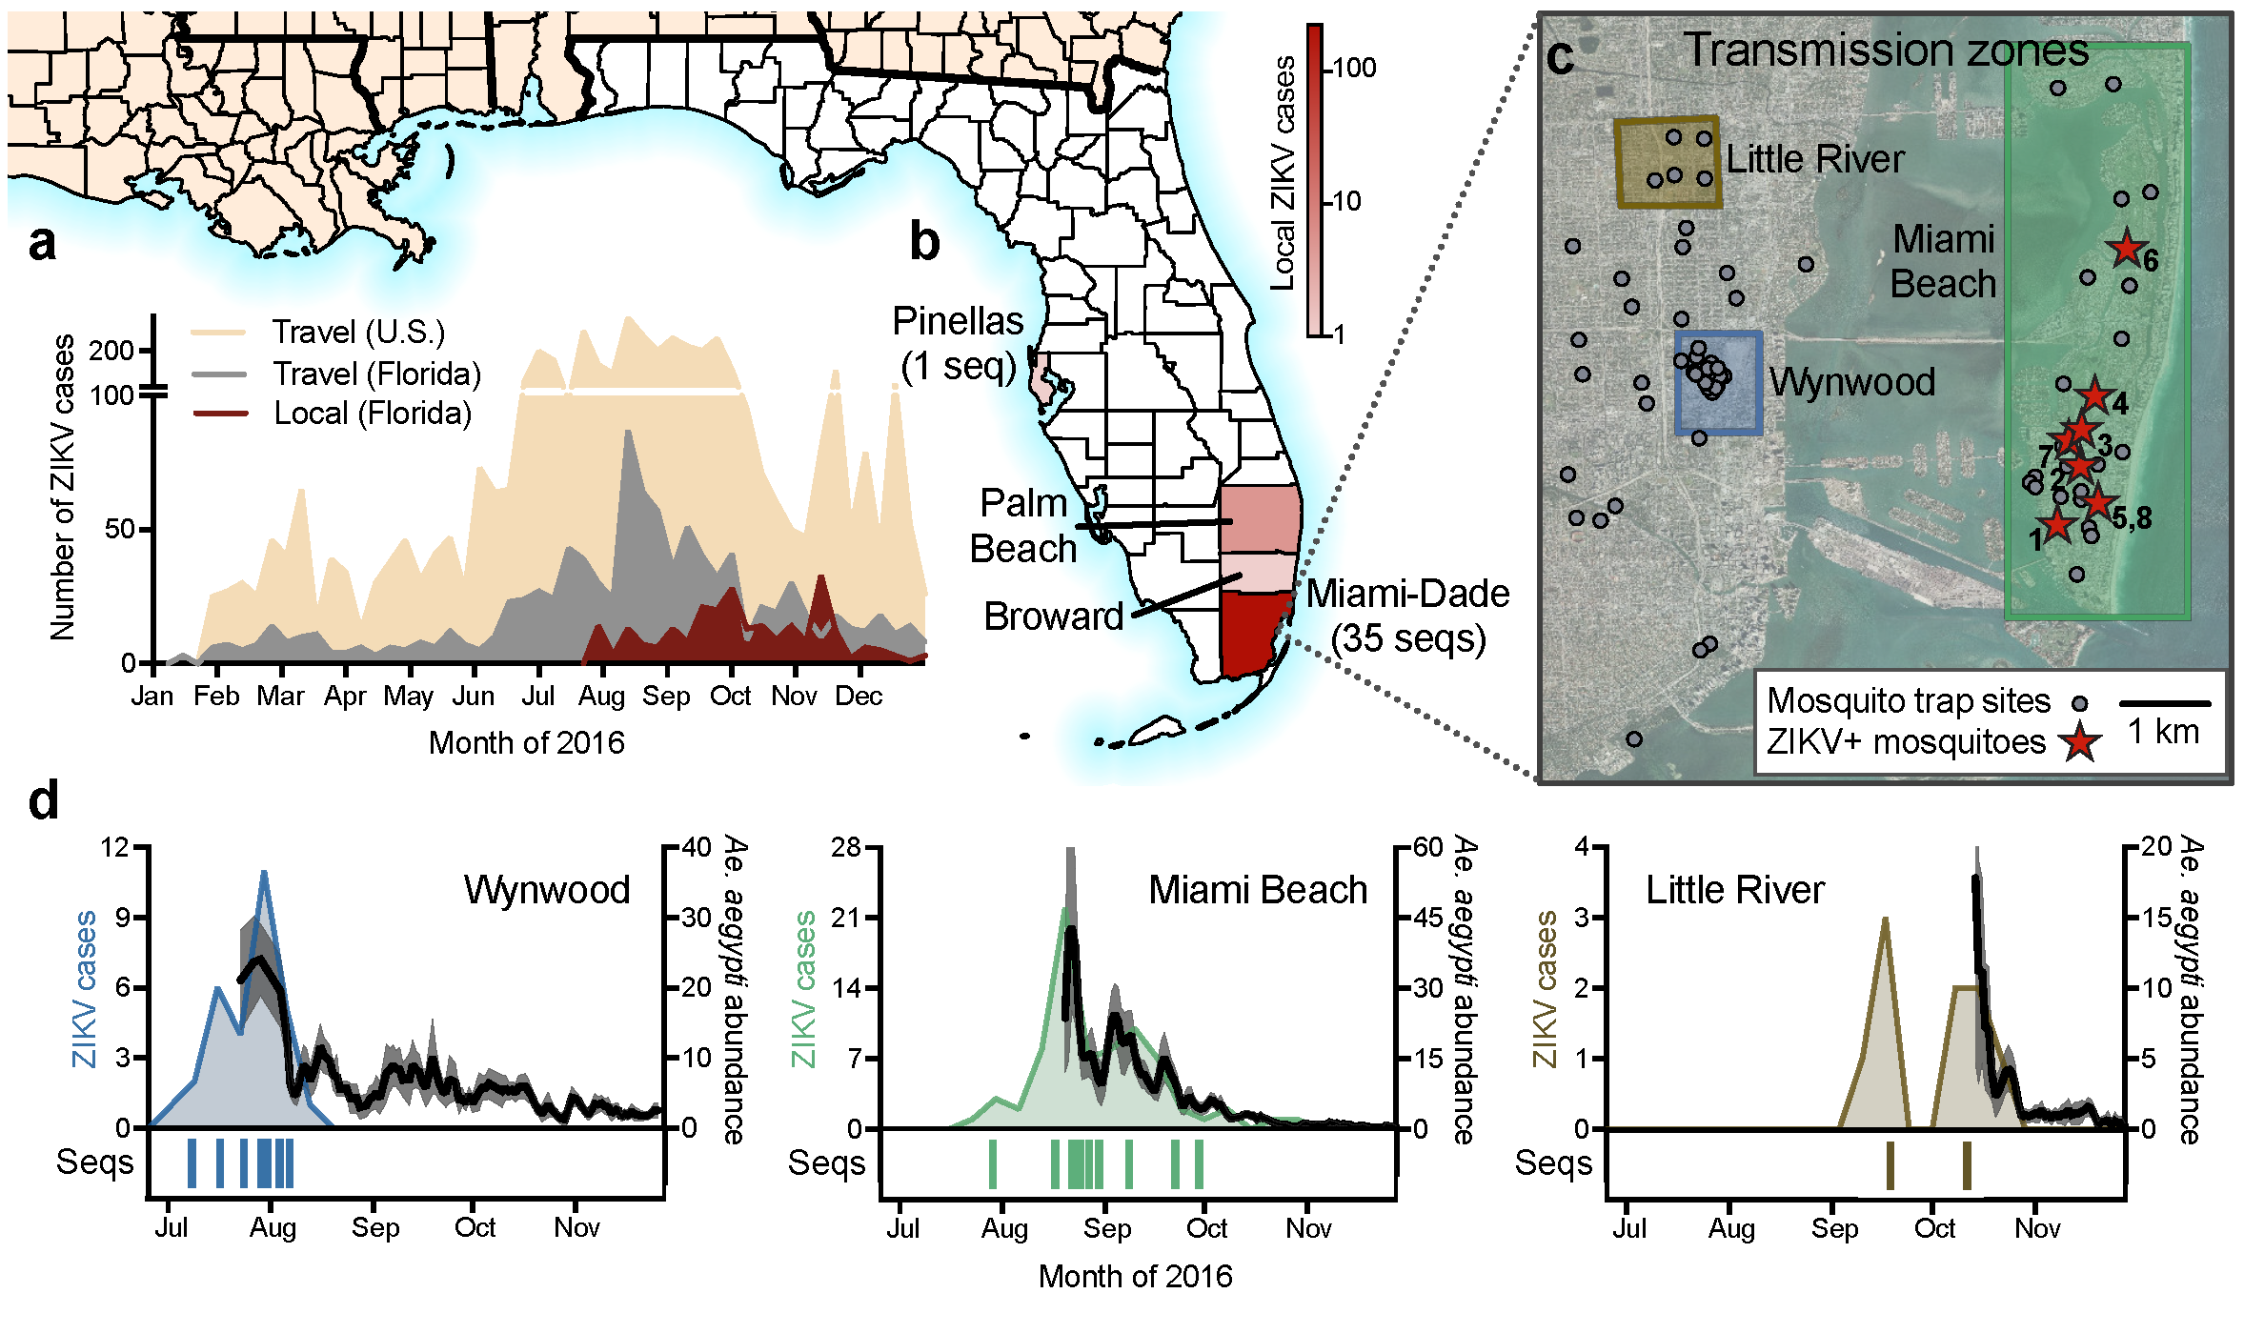
Graphical Concepts
Spring 2023
PCfB Class 9
March 24, 2023
Grubaugh et al. 2017, Nature
Dudas et al. 2017, Nature

Slide 4
Objectives
Overview of graphical concepts
Exposure to editing programs

Slide 5
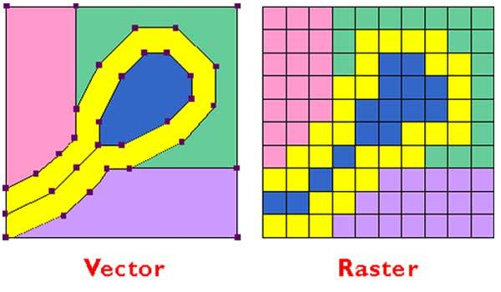
Types of digital images
vector-based
pixel-based

Slide 6
Vector-based images
Composed of independent shapes
Each shape editable as a unit

Slide 7
Pixel-based images (raster)
Composed of squares of different colors
Only editable by changing the colors of individual squares

Slide 8
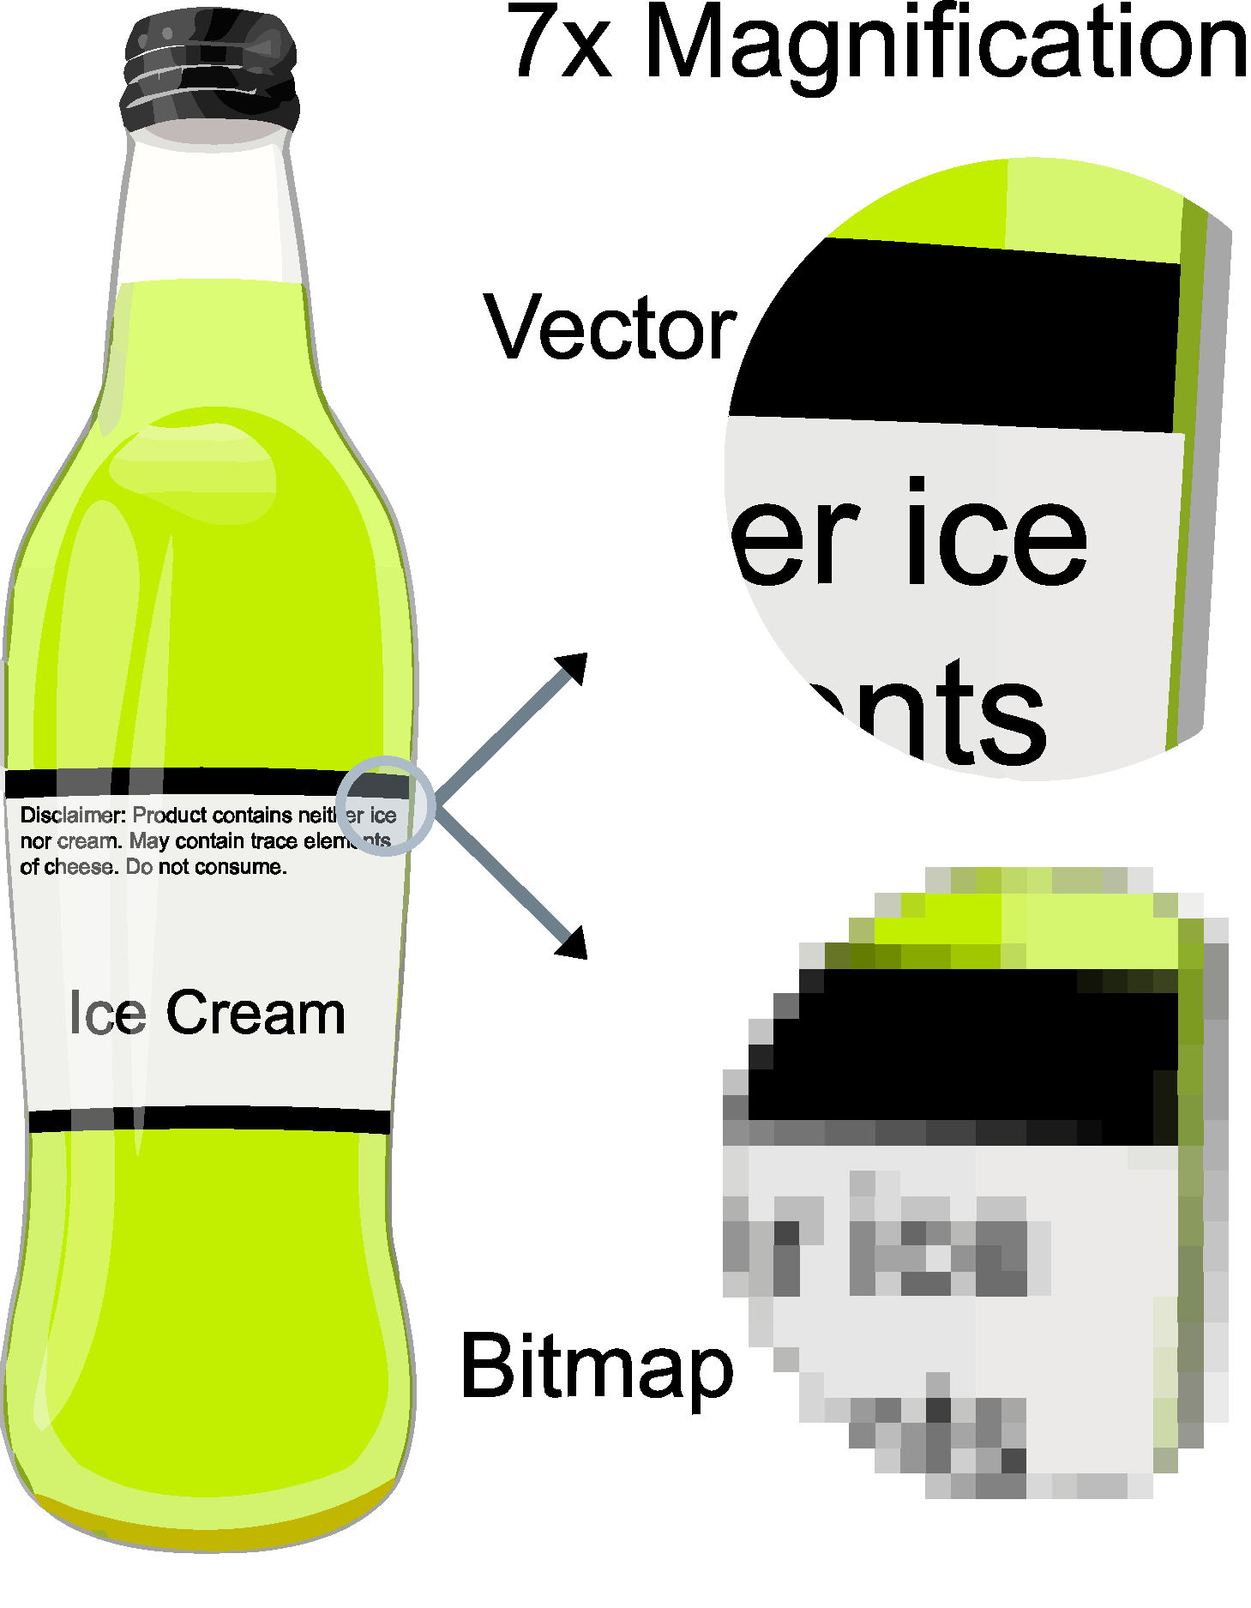
Use vectors whenever possible!
Maintain clarity at any size
Easy to edit
Can always convert to pixels
Searchable

Slide 9
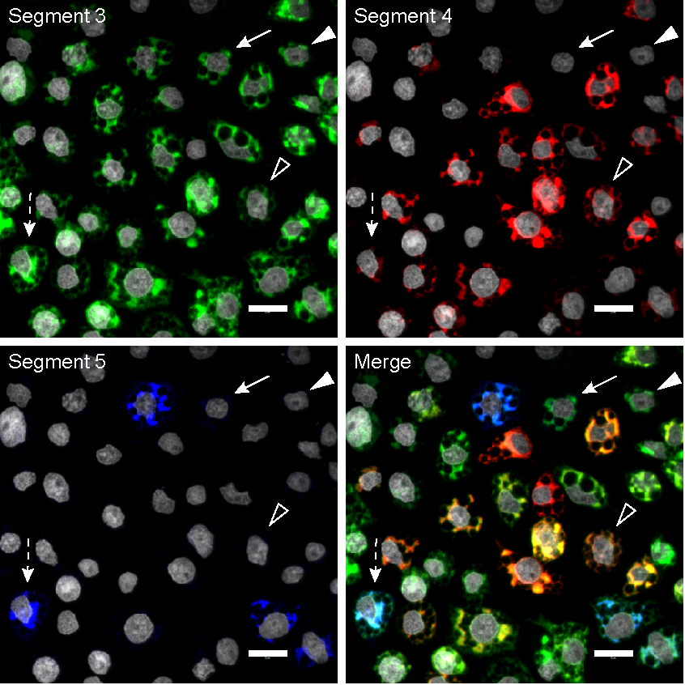
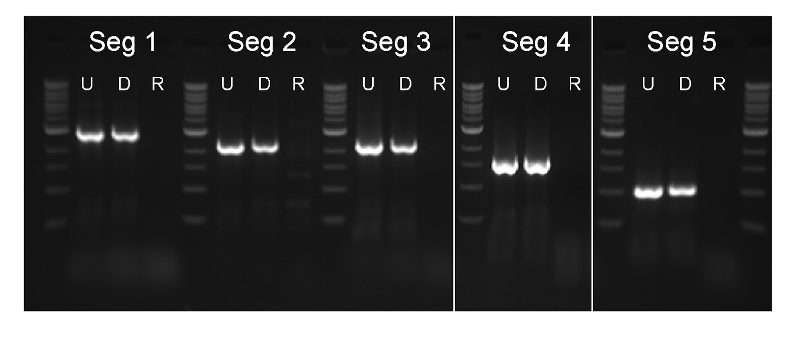
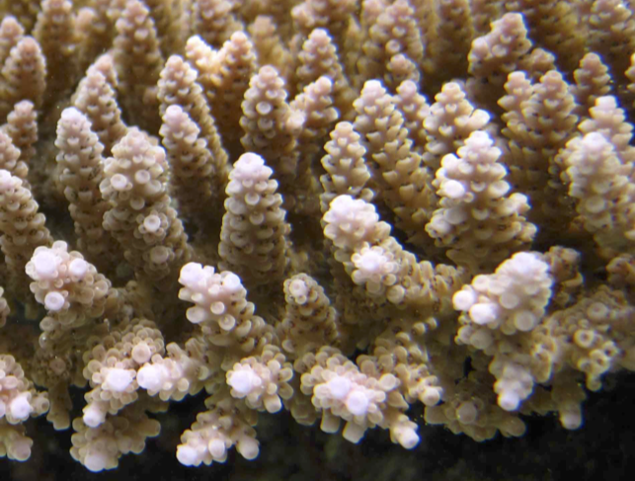
1st exception = photographs

Slide 10
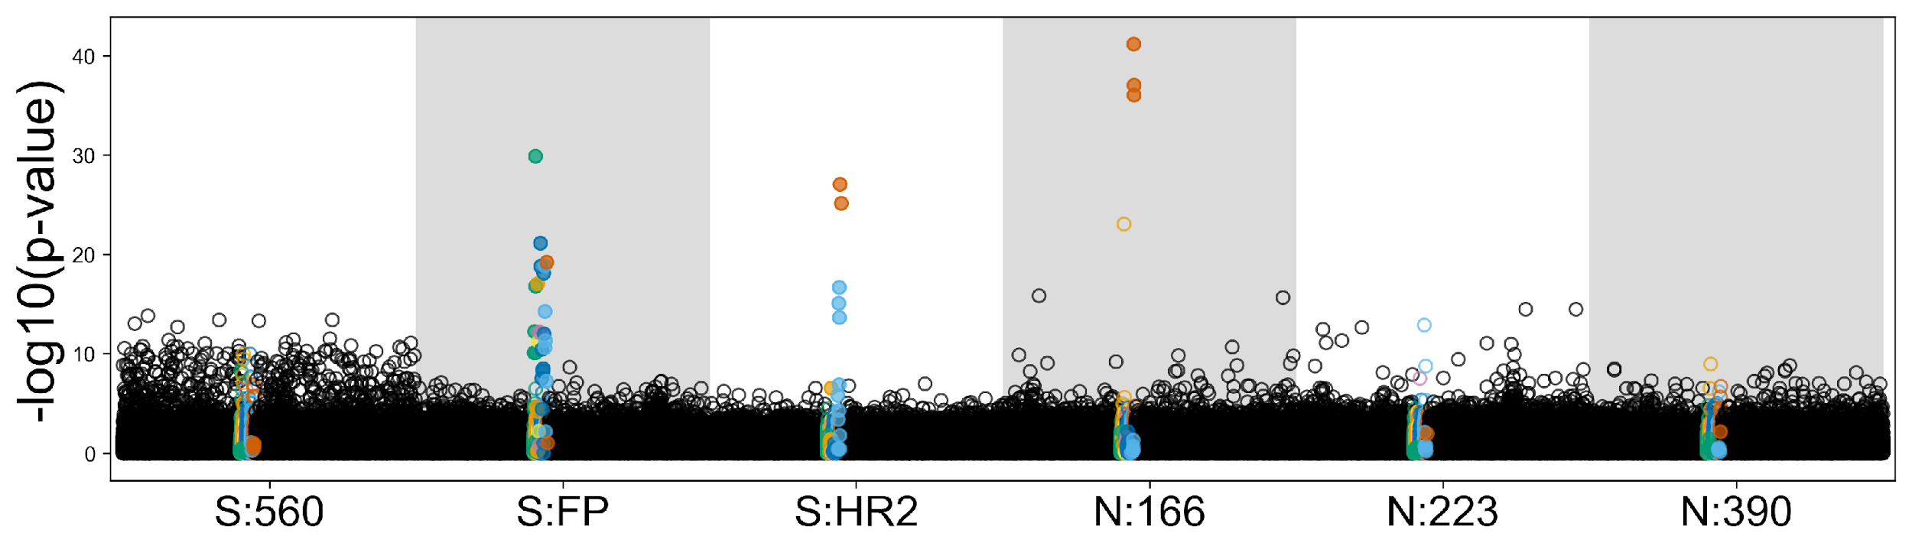
2nd exception = complex figures

Slide 11
How to generate vector images
Draw images from scratch
Trace a photograph
Export from most programs

Slide 12
Know your file formats!
TIFF
PDF
PNG
AI
PSD
PS
SVG
GIF
EPS
BMP
JPEG
JPG

Slide 13


Working with vectors
Adobe Illustrator
Inkscape

Slide 14


Working with pixels
Adobe Photoshop
GIMP

Slide 15
Objective
Familiarize yourself with both vector-based and pixel-based graphics editing programs

Slide 16
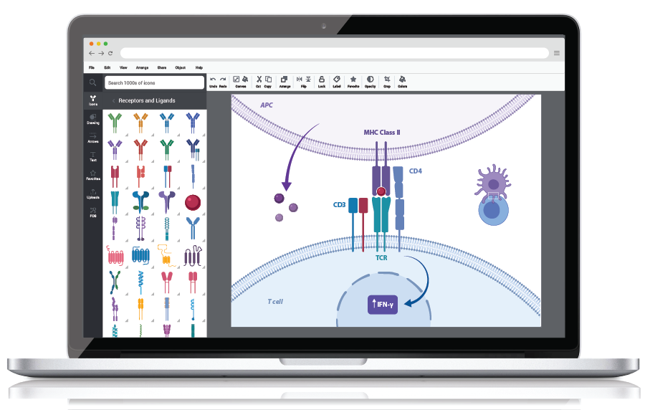
BioRender

Slide 17
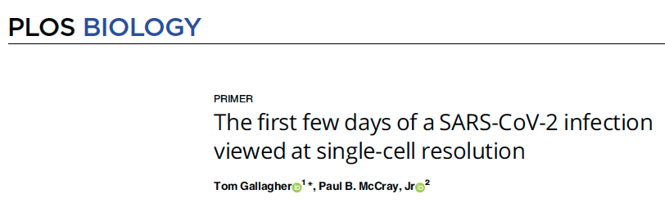
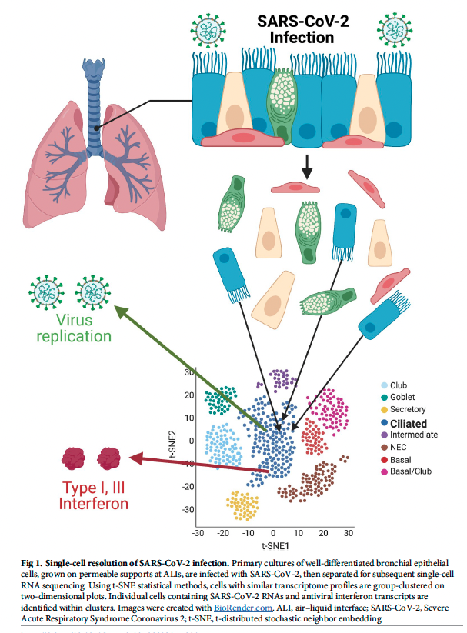

Slide 18
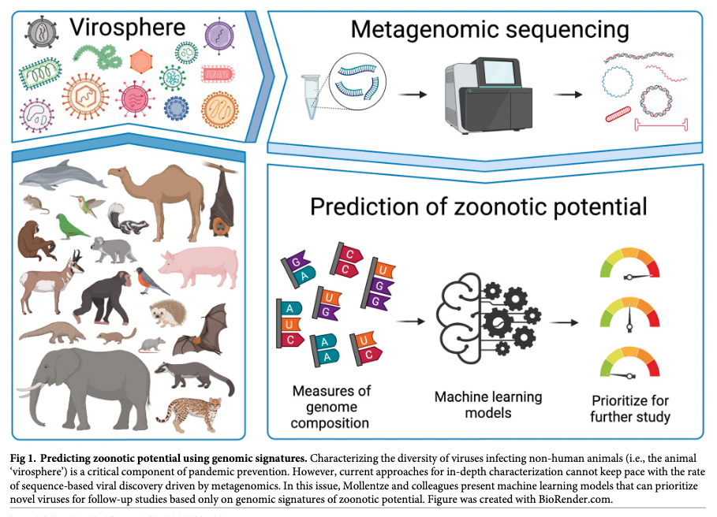

Slide 19
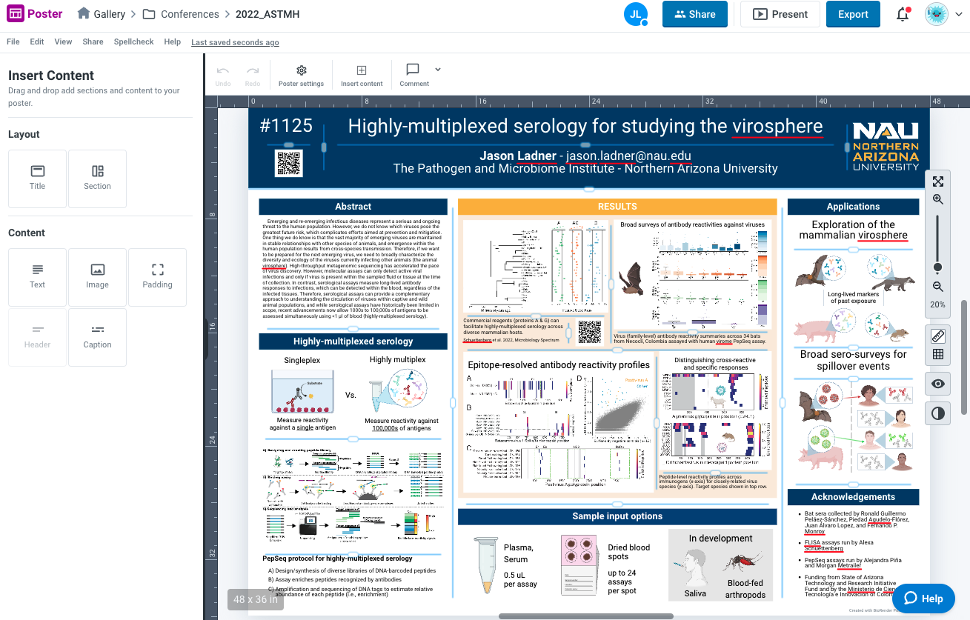

Slide 20
BioRender Demo

